Slide 1
MakeMargins
Enrollment No. – 180320132051
{Internship} Name – Dhairvi Shah
Mentor – Prof. Urmi Shah

Slide 2
Topics to be covered
Introduction
Background
Methodology
Results
Conclusion
References

Slide 3
Introduction
1.

Slide 4

System Description:
MakeMargins is basically an e-commerce platform which will help in bringing retailers and end consumers closer to one another based on their locality.
Mobile application, both Android as well as IOS will be provided to the users.
Basically, provides OMNI CHANNEL

Slide 5



Main Objective:
Here different retailers will be creating their own website with our help and take their business online to keep up with today’s world.
If anybody has already been on online platform then we will help them to connect to their respective customers more progressively as well as help in making new clients.
All the retailers of the city are brought together and a customer is recommended one of them depending on their location.

Slide 6

Scope:
Online selling and purchasing offer innumerable benefits to both sellers and buyers, and these advantages are also the reasons for the rising scope of ecommerce.
It has also marked its place for supplier and retailer field as in B2B2C platform
This has a very bright future in each and every aspect.

Slide 7
Background
2.

Slide 8



Frontend:
HTML
JavaScript
CSS
Backend:
.NET
C++

Slide 9
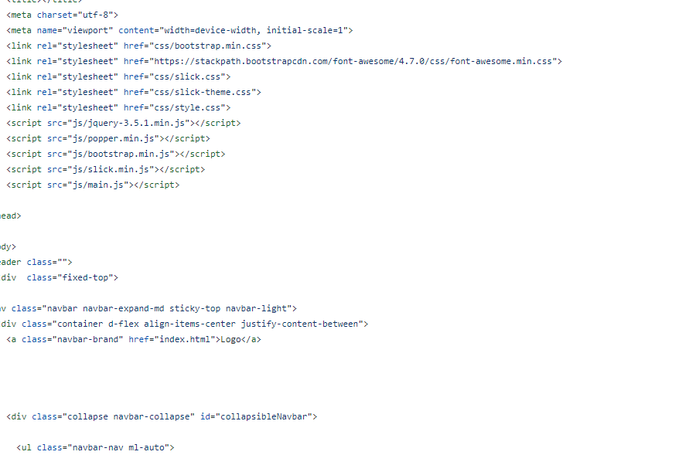
HTML

Slide 10
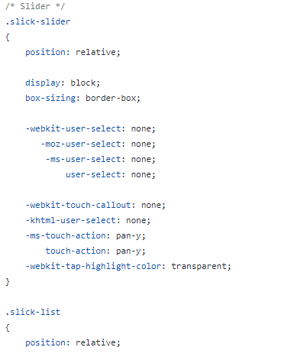
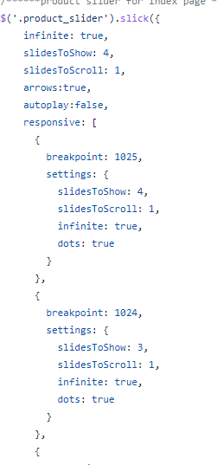
CSS
JS

Slide 11
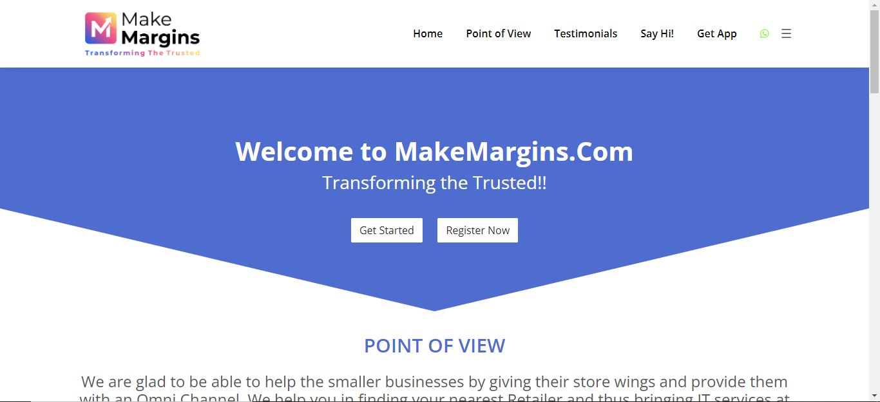
Front End Review

Slide 12
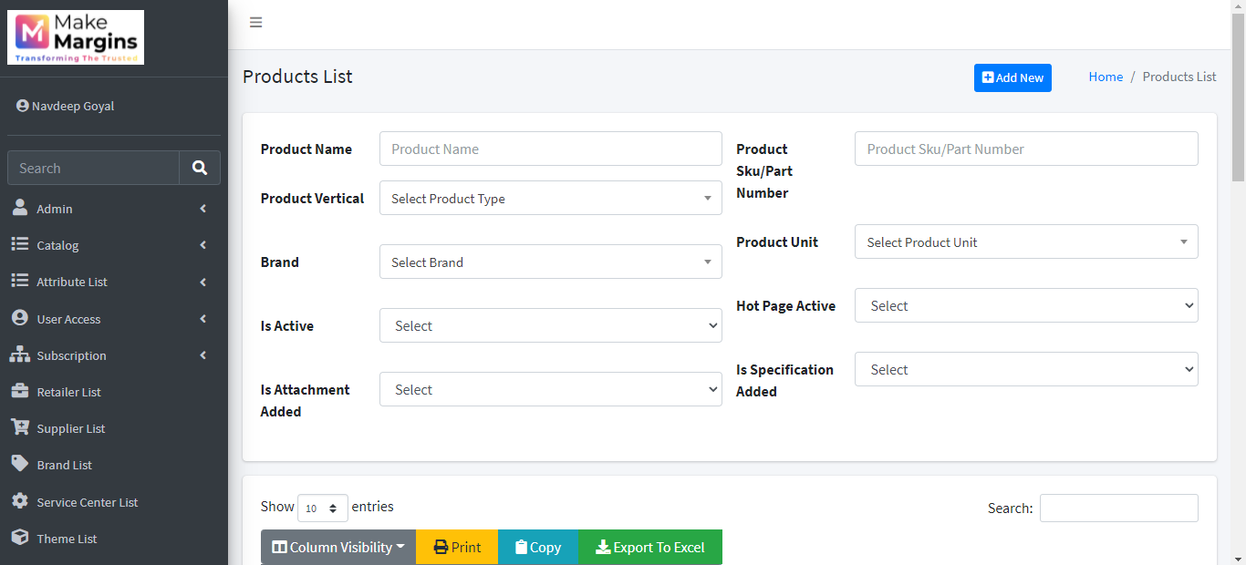
Backend Review

Slide 13
Methodology
3.

Slide 14
Retailer’s view:
Step1: Register as a new user OR Login if existing user
If Register: Upload necessary documents for
verifications and choose plan
Step 2 : Choose your store design and content
Step 3 : setup your store online
Step 4 : keep database of your customer updated
Step 5 : purchase from supplier
Step 6 : put up offers and schemes

Slide 15
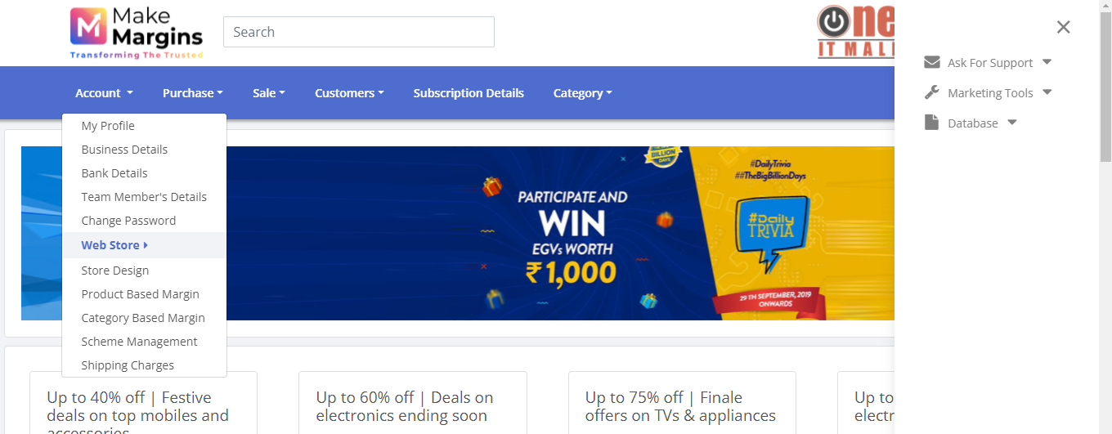
Retailer’s View

Slide 16
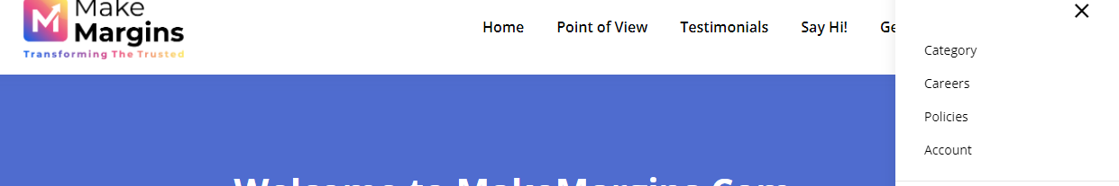
Customer’s pathway:
Step 1 : visit WWW.makemargins.com and go to categories
Step 2 : choose your products
Step 3 : redirected to website of nearest retailer
Step 4 : enjoy online shopping
Step 1

Slide 17
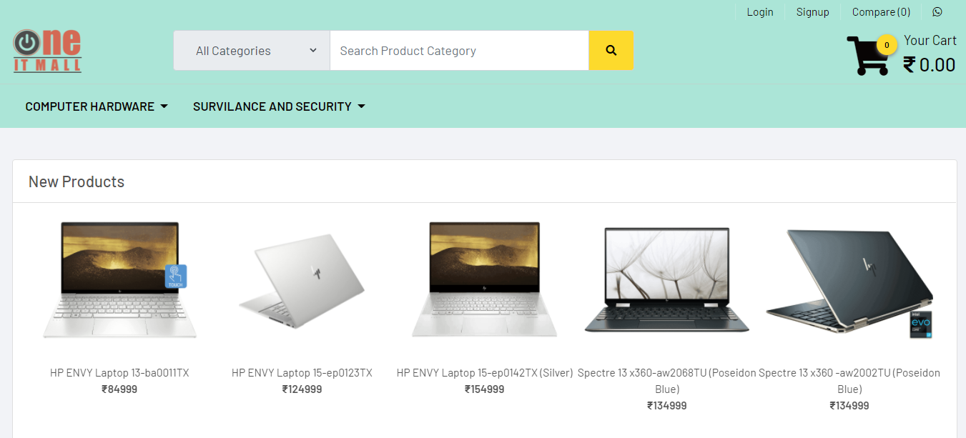
Redirection to nearest retailer’s site

Slide 18
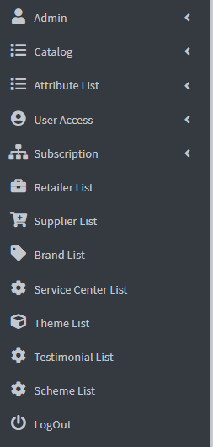
Admin’s Role:
Role 1: Upload , update and maintain the categorical products
Role 2 : administer working of Suppliers and Retailers
Role 3 : verify all users during their account creations
Role 4 : provide them with subscription plans ,
data base, schemes and marketing EDMs
Role 5 : provide different website designs and themes
Role 6 : provide role base access

Slide 19
results
4.

Slide 20
www.makemargins.com ( main website )
www.makemargins.com/admin (admin panel)
www.Oneitmall.com ( sample website of a retailer)
Other documentations on :
https://github.com/DhairviShah/Summer-Internship.git

Slide 21
Conclusions
5.

Slide 22

Online shopping and e-trading is the future and so its only logical to update every field and aspect of business as soon as possible .
This module will help small businesses to enhance their profit with minimum investment.
It will bring business closer and would aggrandize B2B2C platform on large scale.

Slide 23



Advantages :
Helps in saving time and money of consumer
One stop destination
Easy to use and understand
Helps small retailers to upgrade and increase their business

Slide 24



Limitation :
Hard to update such a huge database from time to time
Due to detailed verification process , it is slow process and time consuming
Cannot provide uniqueness to each and every retailer

Slide 25
References
6.

Slide 26
For Designing Purpose :
https://in.pinterest.com/
https://speckyboy.com/
https://psdfreebies.com/
https://www.shopify.in/

Slide 27
For HTML :
https://getbootstrap.com/
https://tailwindcss.com/
https://tailblocks.cc/
For JavaScript :
https://devdocs.io/javascript/
https://www.w3schools.com/JSREF/DEFAULT.ASP
https://jsdoc.app/

Slide 28
Others :
https://github.com/DhairviShah/Summer-Internship.git
https://github.com/

Slide 29
Thankyou

